Slide 1
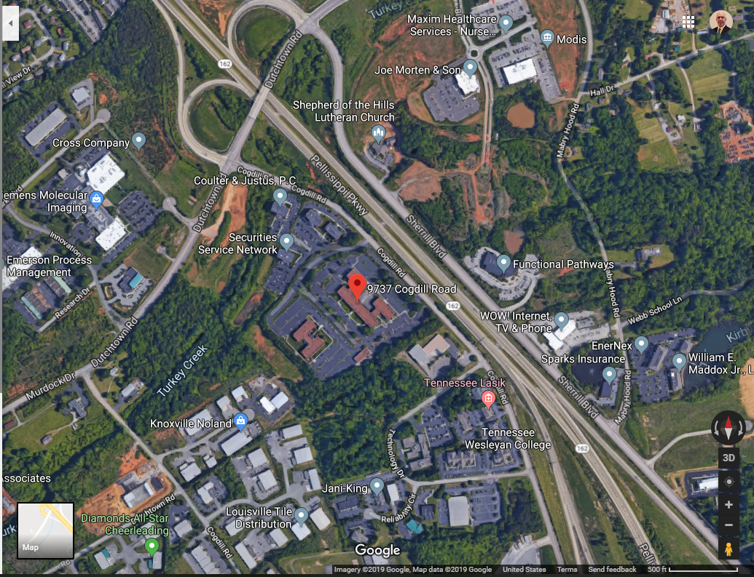

Slide 2
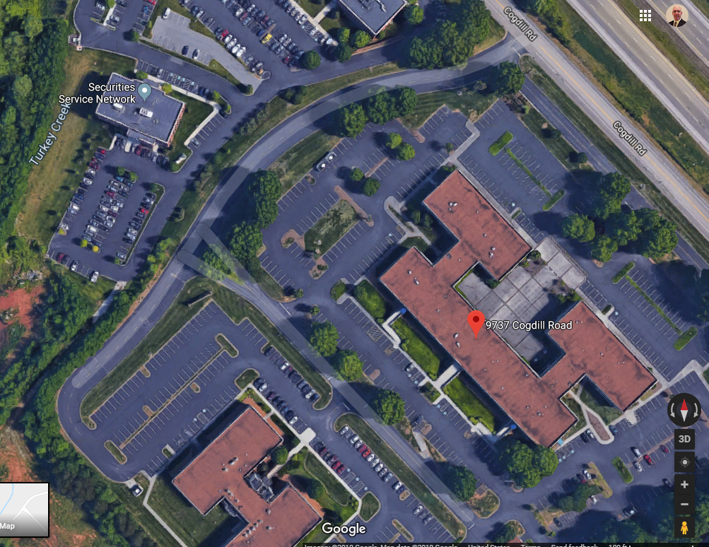
Park Here
Enter Door
at Top of Ramp

