Slide 1
Human Trafficking in Practice and Fieldwork for Therapy Students, Practitioners, and Educators
Toni Thompson, DrOT, OTR/L
Tennessee Occupational Therapy Physical Therapy Conference
October 2023

Slide 2
WARNING!
This information may upset you.
If you feel uncomfortable, feel free to leave the session.
BE SURE to speak with someone about your discomfort.
FEEL FREE TO CONTACT ME ANYTIME IMMEDIATELY AFTER THE PRESENTATION OR in the future.
TONITA7@GMAIL.COM. 813 469 4952

Slide 3
OBJECTIVES
The participant will be able to:
1. Explain the scope of trafficking based on United Nations 3-P Protocol.
2. Identify signs and biopsychosocial effects of trafficking in adults and children, in all settings.
3. Define current scope of PT and OT in anti-trafficking efforts.
4. Evaluate the distinct value of our therapies in anti-trafficking endeavors.
5. Discuss ways to fight trafficking in small, every-day actions.

Slide 4
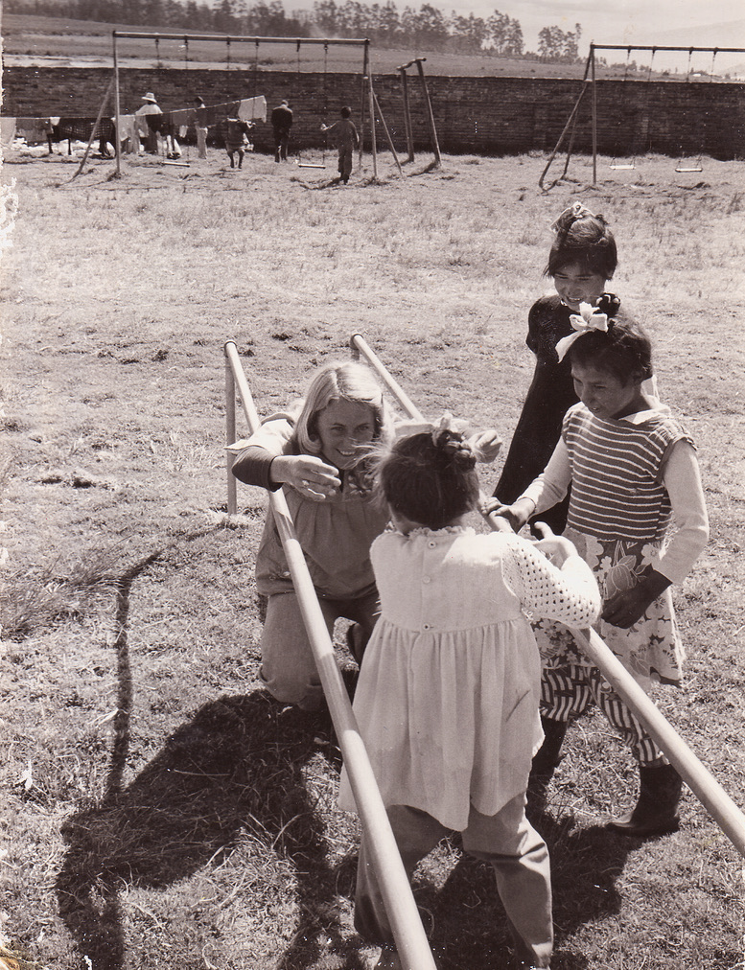
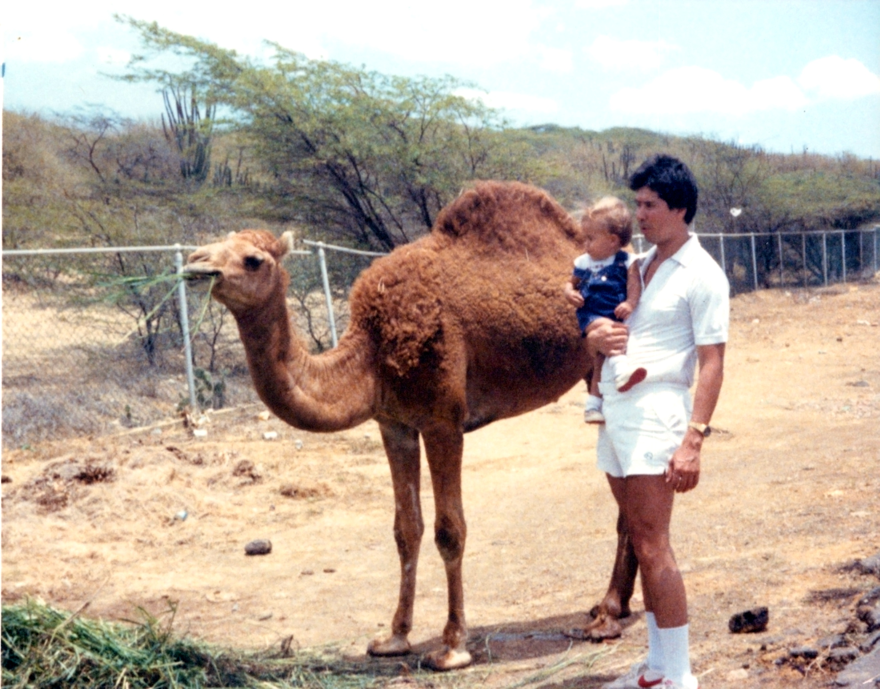
WHY ME??
Image Credit: TONI THOMPSON, © 2023

Slide 5
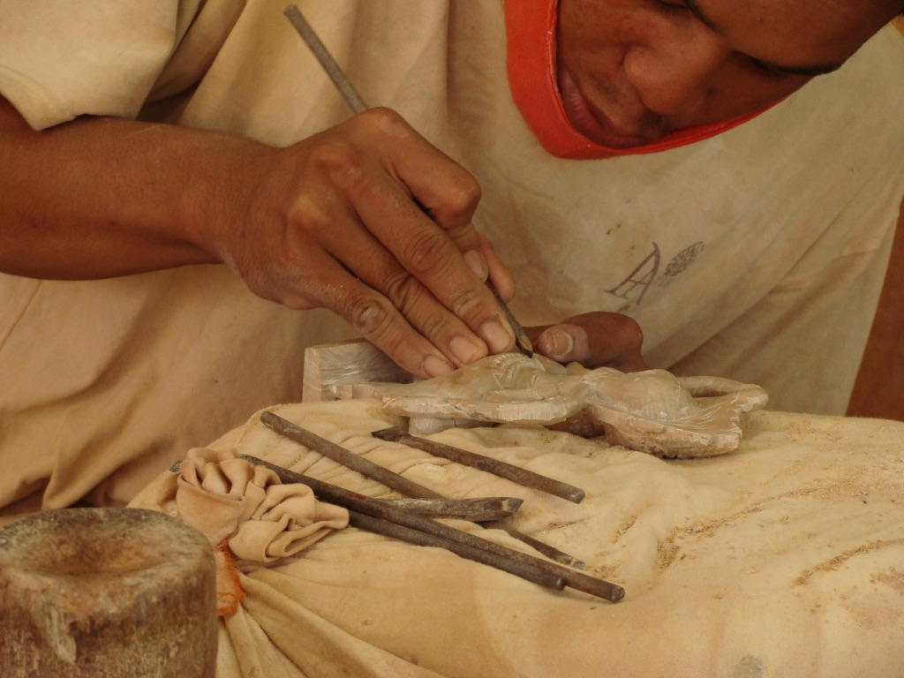
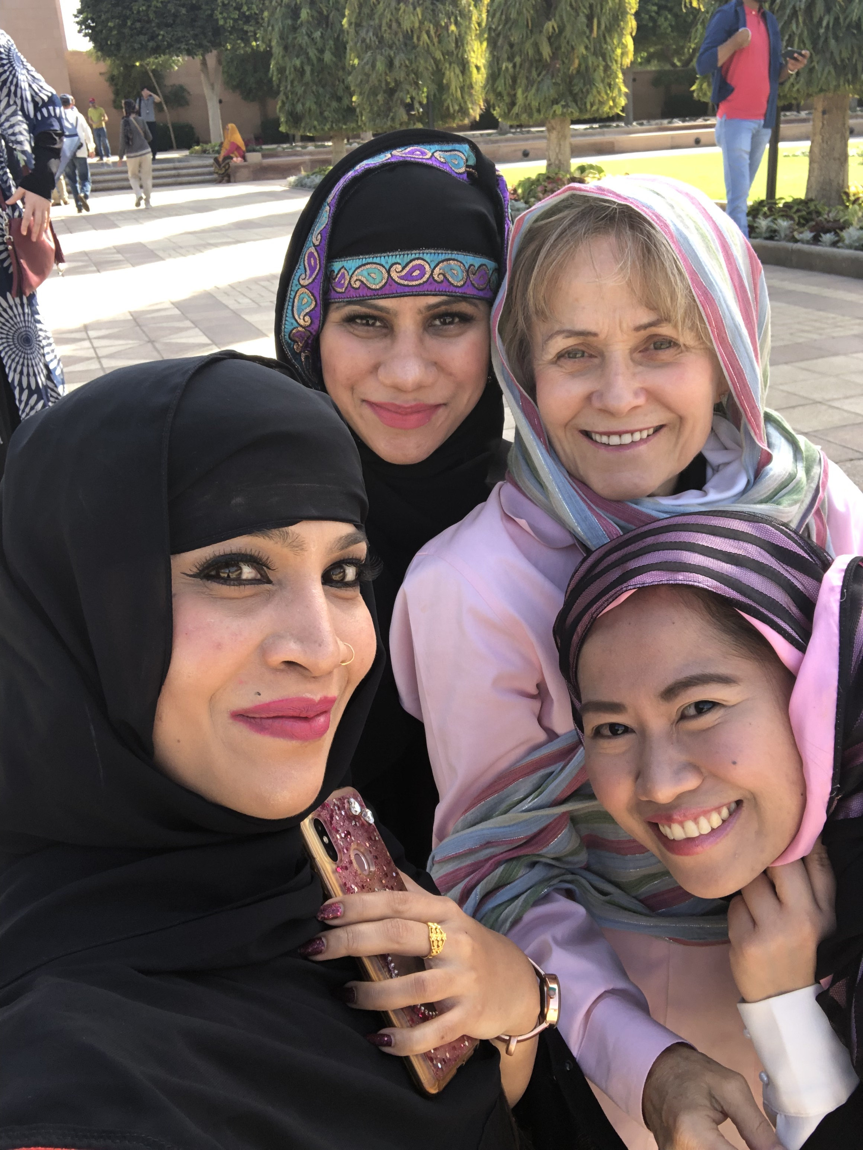
Image Credit: TONI THOMPSON, © 2023

Slide 6
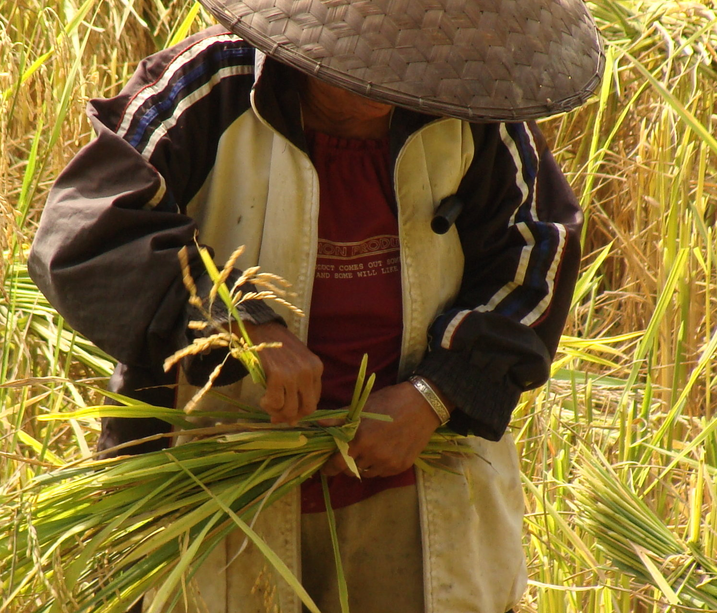
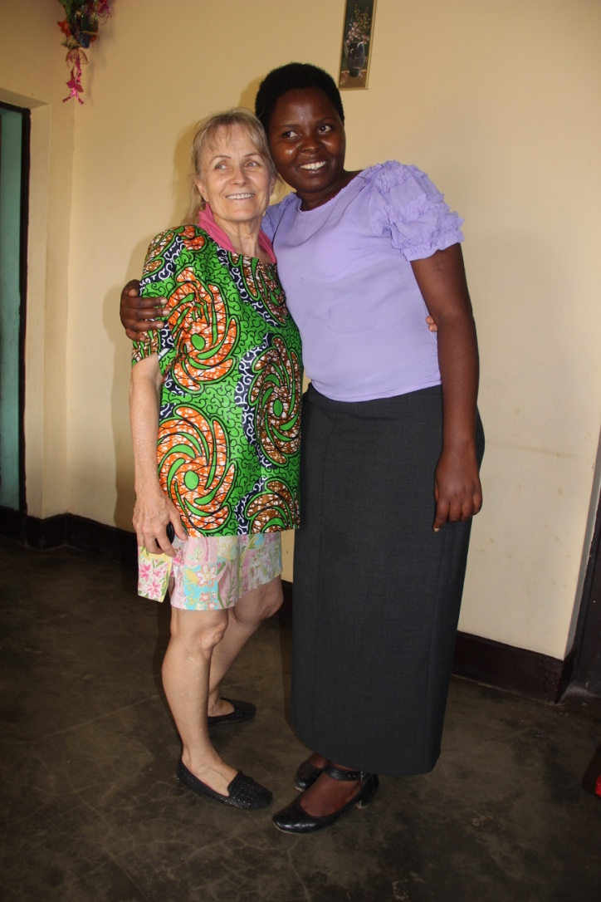
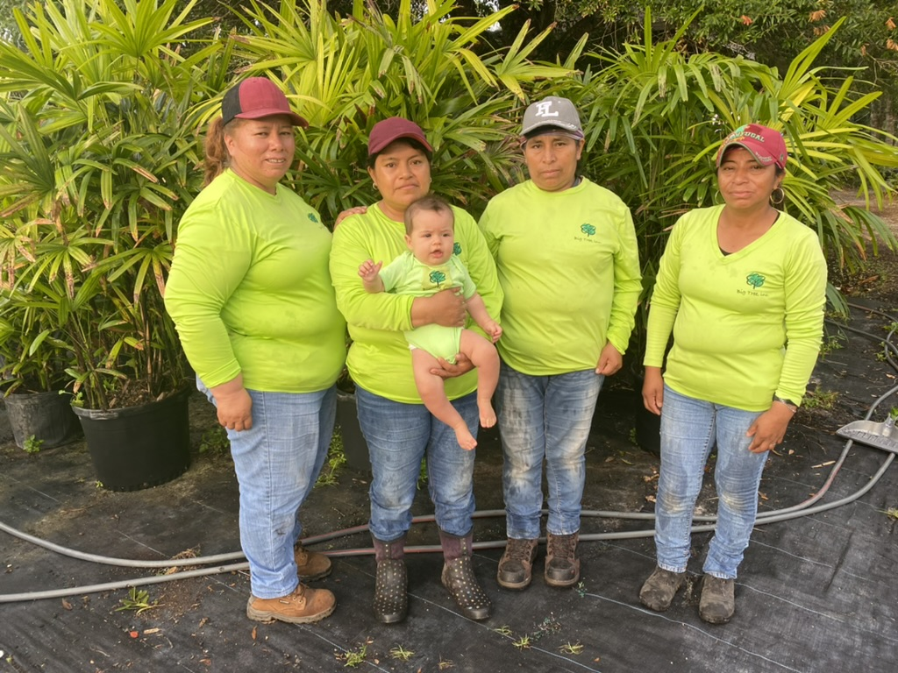
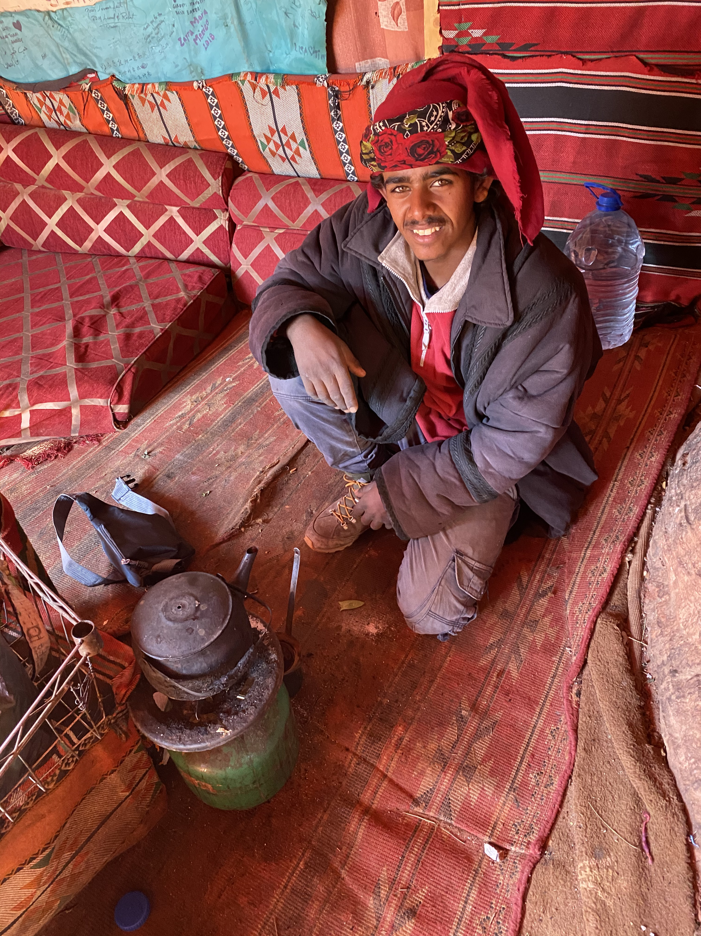
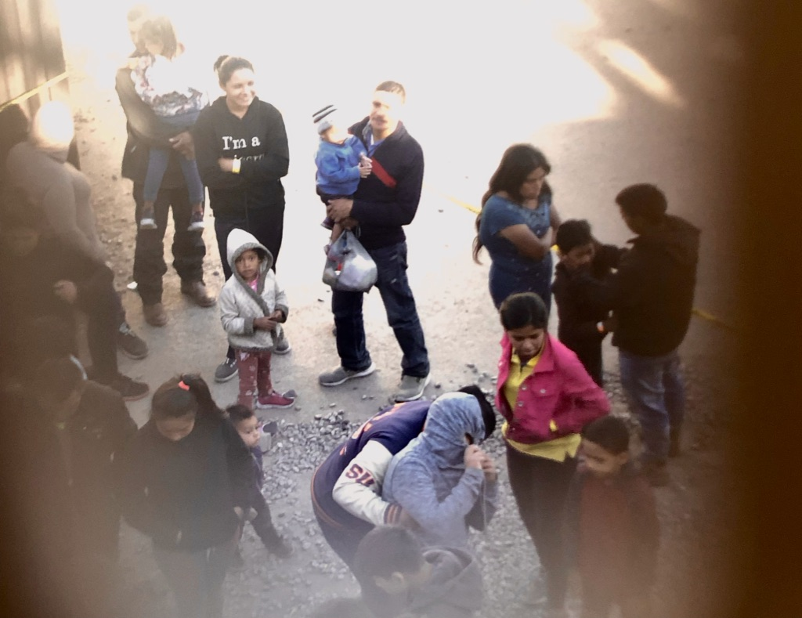
Image Credit: TONI THOMPSON, © 2023

Slide 7
WHAT IS Trafficking?
The UN Protocol to Prevent, Suppress and Punish Human Trafficking considers trafficking as
trafficking in persons, which shall mean the recruitment, transportation, transfer, harbouring or receipt of persons, by means of the threat or use of force or other forms of coercion, of abduction, of fraud, of deception, of the abuse of power or of a position of vulnerability or of the giving or receiving of payments or benefits to achieve the consent of a person having control over another person, for the purpose of exploitation. Exploitation shall include, at a minimum, the exploitation of the prostitution of others or other forms of sexual exploitation, forced labour or services, slavery or practices similar to slavery, servitude or the removal of organs.
(UN, 2000; UN 2023; UN Office on Drugs and Crime [UNODC], 2020; 2004).

Slide 8
types of Trafficking
Sexual activities
Labor practices
Forced marriage
Debt bondage vs. people smuggling
Organ removal and trafficking
ALL slavery = exploitation.
(International Labour Organization [ILO], 2012, 2020; Lloyd, 2011; United Nations, 2020;United Nations, 2023; United Nations Children’s Fund, n.d.; UNODC, n.d.a.)
Notes:
1972 Italy experience ---
Friend on yacht 1970s

Slide 9
Trafficking BY THE NUMBERS
Clandestine nature of trafficking → Statistics
29 million to 49 million . . .
or more?
(Alvarez & Alessi, 2012; Bryant et al., 2015; Dank et al., 2014; Estes & Weiner, 2001; Hardy, Compton, & McPhatter, 2013; ILO, 2020; Lloyd, 2011; Hodge, 2014; Meshkovska et al., 2015; Nawyn et al., 2013; United Nations, 2020; United Nations Children’s Fund, n.d.).

Slide 10
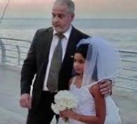
Trafficking BY THE NUMBERS
25M labor trafficking
1 in 4—25% children
15M forced marriage
x

Slide 11
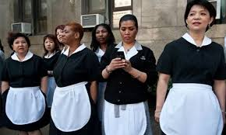
Trafficking BY THE NUMBERS
25 M people in labor activities
74% adults 26% children
--garment industry ($171B)
--domestic workers
--hospitality
--construction
--agriculture
--government:
prisons, military agencies,
rebel forces, child soldiers
Notes:
Sex activities includes

Slide 13
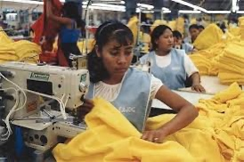
LABOR TRAFFICKING
=
SEX TRAFFICKING

Slide 14
HUMAN trafficking: LABOR LAWS
Fair Labor Standards act 1932
--40-hour work week, time and a half over time
--minimum wage, 2020 $7.25/hour,
--$15/hour
Notes:
Legal bases and guidelines

Slide 15
HUMAN trafficking: LABOR LAWS
1963: Agriculture workers included
NO overtime for agriculture workers until 2019
--50-hour work week
--children $4.25/hour in some states
--Door-to-door sales excluded
--Domestic workers excluded
--Contracted custodians, sweatshops??
Notes:
Legal bases and guidelines

Slide 16
STATE LABOR LAWS
Tennessee & Florida
Regulates minors’ hours
Age 14-17
Restricts types of work
Restricts types of machinery
Restricts work hours: school
Florida
Allows children to work in agriculture with family members

Slide 17
TENNESSEE vs. FLORIDA LAWS
“Minors of any age may be employed:…in domestic or farm work in connection with their own homes or the farm or ranch on which they live, or directly for their own parents or guardian, or in the herding, tending, and management of livestock, during the hours they are not required by law to be in school.”
Notes:
Legal bases and guidelines

Slide 18
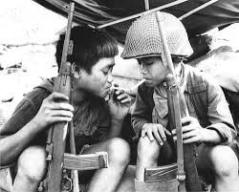
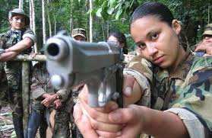
https://junior.scholastic.com/issues/2018-19/010719/kids-at-war.html

Slide 19
SEX TRAFFICKING
Trafficking
does NOT mean
Transportation
Forced sexual acts
Prostitution
Pornography
Dancing
https://www.nationalreview.com/2018/08/porn-human-trafficking-reinforce-each-other/

Slide 20
SEX Trafficking BY THE NUMBERS
Coerced sexual activities
90% female
10% male
?% LGBTQ
60% with group home or foster home life
33% of homeless heterosexual youth trafficked
20% of homeless youth LGBTQ
58.7% LGBTQ youth trafficked
(Martinez & Kelle, 2013; United Nations, 2020; United Nations Children’s Fund, n.d.; UNODC, n.d.b.). https://www.google.com/search?sxsrf=ALeKk03lmYGPkq99ZBo9ubNQSroannUDvA:1594909760577&source=univ&tbm=isch&q=SEX+)
Notes:
Sex activities includes

Slide 21
SEX TRAFFICKING
Women, men, boys, girls
LGBTQ youth and adults
Average age of abduction: 11 or 12
Girls with hx of sexual abuse
Notes:
1 in 15 girls reportedly abused, 1 in 25 boys reportedly abused, 1in 3, 1 in 5

Slide 22
SEX TRAFFICKING
1 in 15 girls, 1 in 25 boys
report abuse by trusted person
Estimates: 1 in 3 girls, 1 in 5 boys,
LGBTQ youth ???
Notes:
1 in 15 girls reportedly abused, 1 in 25 boys reportedly abused, 1in 3, 1 in 5

Slide 23
Adolescents/Children in residential treatment Centers
80 % have behavior, academic, and attachment (relationship) problems
^{30 to 40 % injure selves,}
Think about or attempt to kill selves,
^{Abuse substances, or}
Do something that engages police.
Affect and Behavioral dysregulation
(Warner, Koomar, Luke, and Cook, 2013).

Slide 24
SEX TRAFFICKING NUMBERS
Sex trafficking demand????
Notes:
1 in 15 girls reportedly abused, 1 in 25 boys reportedly abused, 1in 3, 1 in 5

Slide 25
SEX TRAFFICKING NUMBERS
Sex trafficking demand????
Porn addiction
Notes:
1 in 15 girls reportedly abused, 1 in 25 boys reportedly abused, 1in 3, 1 in 5

Slide 26
What is porn?
$97B ----$12B In US
CHANGES Since 1950
INTERNET Role
Porn Hub

Slide 27
PORNOGRAPHY
Sexually abusive images of children
--age that children see porn
--role in sex trafficking
--porn addiction

Slide 28
TYPICAL LIFESTYLE “IN THE LIFE”
Trafficked 15 to 40 times daily
Notes:
1 in 15 girls reportedly abused, 1 in 25 boys reportedly abused, 1in 3, 1 in 5

Slide 29
TYPICAL LIFESTYLE “IN THE LIFE”
Trafficked 15 to 40 times daily
Deprived occupation,
environment, and
person factors.
“Shelf life” of seven years.
Notes:
1 in 15 girls reportedly abused, 1 in 25 boys reportedly abused, 1in 3, 1 in 5

Slide 30
Pert’s mind-body approach
Biochemical basis of consciousness
sexual abuse facilitates dissociation of negative emotions to be stored into one’s physical body.
“their conscious perception and meaning of ‘self’ seemed to develop from their bodily experience of themselves in their environment” (p. 68). (Candace Pert, Ph.D.) ( Ratcliff., Farnworth, & Lentin,2011).

Slide 31
RESULTING BIOPSYCHOSOCIAL DEFICITS
Medical problems: gynecological, GI, musculoskeletal. . .
Dental deficits
Trauma behaviors
Dissociation
PTSD
Mental health conditions
Coerced substance addiction
Sensory modulation difficulties
Global developmental delays due to deprivation
Social
Emotional
Occupational
Cognitive
Sensorimotor
Neurological.

Slide 32
HOW DO YOU KNOW SOMEONE IS BEING TRAFFICKED?
WHAT SIGNS DO YOU LOOK FOR?

Slide 33
WHAT TO LOOK FOR
Inconsistent history and symptoms
Poor eye contact, reluctance
Controlling caregiver
Unexplained or unusual bruises and injuries
Dental deficits
Musculoskeletal injuries
Trauma behaviors
Sensory modulation difficulties
Delays in behavior:
Social
Emotional
Occupational
Cognitive
Sensorimotor
Neurological.

Slide 34
WHAT TO LOOK FOR
Triggers
Sensory inputs that trigger negative physiological or psychological reactions
smells
sights
sounds and noises
tastes
tactile input
Internal: memories, anxiety, pain, anger,
Anniversary dates
(Awkolaw, 2020).
Notes:
Reintegration and Repatriation.

Slide 35
LITERATURE REVIEW OF RECOVERY
Geographic Scope
United States
International
Fields of Study
Human Rights
Trauma/Violence/Sexual Trauma
Psychology/Psychiatry
Social Work
Religious
Psychiatric Nursing
Medical care, including Gynecology
Dentistry
Education . . .

Slide 36
Variety of assessment tools/approaches
PTSD
Depression
Trauma
Resiliency
Cognitive skills
Self-esteem
Cortisol level and physical problems
Neurophysiological concerns.
Trickett, P.K., Noll, J.G., & Putnam, F.W. 2011.

Slide 37
Therapeutic approaches
Eye Movement Desensitization and Reprocessing (EMDR) (Maxfield, 2003; Shapiro, 1989).
^{Expressive therapies.}
^{Art therapy (Pifalo, 2007).}
Music therapy (Strehlow, 2009).
^{Sand tray (Zhang, 1998).}
Animal-assisted therapy (Dietz, Davis, & Pennings, 2012; Parish-Plass, 2008).
^{Equine therapy.}
^{Psychopharmacology.}
^{Anti-depressants.}
Pain relief (Mohta, Sethi, Tyagi, & Mohta, 2003).
^{Anti-anxiety meds.}
Benzodiazepines--can increase Dissociation (Gentile, Dillon, & Gillig, 2013).
^{(De Chesney, 2013).}

Slide 38
Sex trafficking & OT
NSU-Tampa OTD students (Bryant et al., 2015)
Thailand: Pre-vocational OT (Phongphisutbubpa, 2007).
Relaxation kit (Snider, 2012).
Potential misuse of OT (Lisborg, 2009).
Comprehensive direction for OT action
(Cerny, 2016; Gorman & Hatkevich, 2016; MartIn, 2015).
Occupation-based groups for trafficked teens (Martin, 2015)
Community Integration club for women in recovery (Thompson, 2017).
Curriculum for therapy education (Peters, 2020).

Slide 39
Sex trafficking & OT
AOTA Pre-conference workshop 2019.
Student doctoral capstones since 2017.
-Chinese woman labor trafficked & new mother
-A big blow up in a shelter
-The role of occupational therapy for survivors of human trafficking, Capstone. (Mariano, 2019).
-Sleep hygiene (Ninan, 2023).
-Scoping review of trafficking and OT (Branem, in progress.)
-Curriculum for university education, , in progress.

Slide 40
IMPEDIMENTS TO PT & OT INVOLVEMENT

Slide 41
IMPEDIMENTS TO PT & OT INVOLVEMENT
Funding
Research
Evidence
Precedent

Slide 42
In the absence of evidence for therapy involvement in trafficking, what can we do?

Slide 43
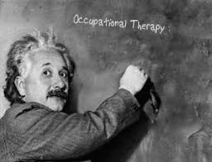

Slide 44
In the absence of evidence . . .
Utilize similar medical or mental health conditions.
Utilize similar signs and symptoms.
Incorporate a recovery model.
Incorporate a trauma-informed
approach.
5. Focus on occupation and function.

Slide 45
SIMILAR CONDITIONS and SYMPTOMS???

Slide 46
SIMILAR CONDITIONS and SYMPTOMS???
Domestic violence
Sexual Abuse (minor or adult)
PTSD
Traumatic event
Refugees (Shigekane, 2007)
Post-concussion
TBI
Mental health diagnosis

Slide 47
Substance Abuse & Mental Health Services Administration (SAMHSA) RECOVERY MODEL PRINCIPLES
Safety.
Trustworthiness and Transparency.
Peer support.
Collaboration and mutuality.
Empowerment, voice and choice.
Cultural, Historical, and Gender Issues.
(SAMHSA, n.d.)

Slide 48
Recovery Model: Key domains
Affect stability.
Behavioral adjustment.
Cognitive mastery.
Developmental mastery.
Healthy intact Ecosystems.
(Collins & Collins, 2005 in Jordan, Patel, & Rapp, 2013)

Slide 49
COMBINED RECOVERY PRINICPLES/DOMAINS
Affect.
Behavior.
Cognition.
Developmental mastery.
Healthy Ecosystems.
Safety.
Trustworthiness and Transparency.
Peer support.
Collaboration and mutuality.
Empowerment, voice and choice.
Cultural, Historical, and Gender Issues.

Slide 50
Path to service development
Universal base for CARE that is international,
culturally sensitive,
trauma-informed,
multi-disciplinary,
client-centered,
occupation-based.
.

Slide 51
Trauma-informed approach
Use victim-centered approach.
(2) Screen for the risk of sex trafficking.
(3) Decriminalize victim.
(4) Open-ended questions, multiple sessions.
(5) Implement trauma-informed strategies/therapy.
(6) Decrease retraumatization: words, intervention, and location not reflect trafficking experience.
(7) Integrate health-risk goals (e.g., STD, memory).
(8) Include goals that promote
Empowerment
Self-worth
Daily life decision making. (Hardy, Compton, & McPhatter, 2013).
Notes:
(1) ensuring that a victim-centered approach guides the comprehensive assessment (e.g., risk of suicide, medical, comorbid diagnoses, spirituality) and treatment planning; (2) integrating screening items to assess the risk for indicators of domestic minor sex trafficking; (3) using terminology that decriminalizes the victims; (4) using open-ended questions and conducting the assessment over multiple sessions; (5) implementing trauma-focused strategies and therapy methods; (6) decreasing the risk of retraumatization by ensuring that the intervention methods and residential location do not reflect the trafficking experience; (7) integrating goals that respond to the health risks of sex trafficking (e.g., sexually transmitted diseases); and (8) including goals that pro- mote empowerment, self-worth, and daily life decision making.

Slide 52
Trauma-informed approach
Include goals that promote
Empowerment
Self-worth
Daily life decision making
(Hardy, Compton, & McPhatter, 2013)
HEALING CENTERED ENGAGEMENT
(Ginwright, S. 2018).
Notes:
(1) ensuring that a victim-centered approach guides the comprehensive assessment (e.g., risk of suicide, medical, comorbid diagnoses, spirituality) and treatment planning; (2) integrating screening items to assess the risk for indicators of domestic minor sex trafficking; (3) using terminology that decriminalizes the victims; (4) using open-ended questions and conducting the assessment over multiple sessions; (5) implementing trauma-focused strategies and therapy methods; (6) decreasing the risk of retraumatization by ensuring that the intervention methods and residential location do not reflect the trafficking experience; (7) integrating goals that respond to the health risks of sex trafficking (e.g., sexually transmitted diseases); and (8) including goals that pro- mote empowerment, self-worth, and daily life decision making.

Slide 53
Sex trafficking, PT, & OT
3P Protocol of United Nations, 2000
Guidelines for programs and actions of
--governments,
--private agencies,
--non-profits,
--individuals
Foundation for laws, methods, approaches within/across borders
NOT legally directive.
(United Nations, 2020; United Nations Office of High Commission on Human Rights, n.d.).

Slide 54
trafficking LEGAL HISTORY International
United Nations, 2000, 2007
Restitution for rehabilitation, inc. PT & OT.
World Health Organization (WHO).
International Classification of Functioning, Disability, and Health (ICF) (World Health Organization, 2020)
World Federation of Occupational Therapists (WFOT). (WFOT, n.d.)
World PhysioTherapy
(United Nations, 2020; United Nations Office on Drugs and Crime, 2009; United Nations Office of High Commission on Human Rights, n.d.).
Notes:
UN Resolution: establishes importance of OT
WHO ICF: universal base, culturally-sensitive, client-centered
WFOT: interfaces with the WHO ICF

Slide 55
trafficking, PT, & OT: USA
United States TVPA provision for PT & OT
William Wilberforce Trafficking Victim Protection Act of 2000, 2008
Trafficking Victims Protection Reauthorization Act 2013, 2022
Federal Strategic Action Plan on Services for Victims of Human Trafficking in the United States (Cerny, 2016).
18 U.S.C. §§ 1593(b(3) and 2259(b)(3).
Notes:
Legal bases and guidelines

Slide 56
Sex trafficking, PT & OT: USA
American Occupational Therapy Association (AOTA) Vision 2025. (AOTA, 2017).
OT Practice Framework (AOTA, 2014).
AOTA and PT Code of Ethics (AOTA, 2015).
State practice acts to define scope of practice.
http://www.leg.state.fl.us/Statutes/index.cfm?App_mode=Display_Statute&URL=0400-0499/0468/Sections/0468.203.html
Notes:
Legal bases and practice guidelines to develop services that are universal, international, culturally sensitive, trauma-informed, multi-disciplinary, client-centered

Slide 57
HUMAN trafficking: STATE LAWS
Education of law enforcement
Education of related professionals
Expunction of criminal records related to trafficking
--prostitution
--pornography
--drug related felonies
HIV transmission
Relocation assistance
Damages & restitution
--general state funds
--trafficker
Notes:
Legal bases and guidelines

Slide 58
Sex trafficking PT & OT
3P Protocol of United Nations, 2000
3P Protocol Components
Prevention
Protection
Prosecution
(United Nations, 2020; United Nations, 2023; United Nations Office of High Commission on Human Rights, n.d.).

Slide 59
POTENTIAL ACTIONs
United Nations 3P Protocol
Prevention
Protection
Prosecution
(United Nations, 2020; United Nations Office of High Commission on Human Rights, n.d.).

Slide 60
POTENTIAL ACTIONs
Prevention
Awareness campaigns
Public, schools, workplace
Educational endeavors
Rehab practitioners, HC workers
Agency/facility rules and culture
Educate on potential trafficked
persons, trafficking behaviors

Slide 61
POTENTIAL ACTIONs
Protection
Dedicated Recovery Intervention
Outreach
Alternative services
Transitional programs
Prison intervention
Community integration
Males, LGBTQ populations
Identification of trafficked persons at work and outside of work

Slide 62
Specific expertise of Practitioners
Rehabilitation:
Improved physical abilities
Trauma:
Work through presenting behaviors, feelings
NOT re-live, push, “resolve”
Triggers:
Sensory inputs → negative phybiopsychosocial reactions
smells sights tastes
sounds and noises tactile input
Internal: memories, feelings of anxiety, pain, anger,
Anniversary dates (Awkolaw, 2020).
Notes:
Reintegration and Repatriation.

Slide 63
POTENTIAL OT ACTIONs
Prosecution
Empowerment for legal process
Changing legal status criminal→victim
Criminal proceedings
Recovery programs for traffickers and purchasers
Porn addiction treatment

Slide 64
WHAT CAN PT & OT DO?
Evidence-Based Skills
Physical rehabilitation
Financial management
Self-care skills
Meal planning/nutrition
Leisure skills
Computer skills
Social media
Virtual education, cognitive skills
Education
Vocational skills
Home management
Community Integration
SENSORY APPROACH
OCCUPATION!
FUNCTION!

Slide 65
What Can I do?
1. Donate lots of
Volunteer.
Be aware of triggers and reactions in clients, friends, children. Call 1-888-3737-888

Slide 66
What Can I do?
4. VOTE! for local, state, and national politicians, laws, and amendments.
5. Check out with Buycott—Barcode Scanner &QR Bar Code Scanner.
https://www.buycott.com/

Slide 67
What Can I do?
Occupational Therapy Human Trafficking Network on Facebook™
The FREE Network. https://www.freenetwork.us/
AOTA Occupational Injustice and Human Trafficking CEU 1 hour ---- available for reading https://www.aota.org/~/media/Corporate/Files/Publications/CE-Articles/CEA_January_2020.pdf.
(Required) CEUs for HCP
Recycle, Reuse, Buy used!

Slide 68
QUESTIONS?

Slide 69
REFERENCES
Abas, M. , Ostrovschi, N. V., Prince, M.. Gorceag, V. I., Trigub, C., Oram, S. (2013). Risk factors for mental disorders in women survivors of human trafficking: A historical cohort study, BMC Psychiatry, 13, 1-11. Doi 10.1186/1471-244X-13-204
Alshryda, S., & Wright, J. (2014). Levels of evidence. London, UK: Springer-Verlag London.
Awkolaw. (2020). Walking through a field of landmines: Survivors of sexual assault and human trafficking struggle to negotiate trauma triggers https://www.awkolaw.com/walking-through-a-field-of-landmines-survivors-of-sexual-assault-and-human-trafficking-struggle-to-negotiate-trauma-triggers/
American Occupational Therapy Association. (2020). Occupational therapy practice framework: Domains and process (3rd ed.). American Journal of Occupational Therapy, 74(Suppl. 2), 7412410010p1–7412410010p87. 7412410010p1–7412410010p87.doi: 10.5014/ajot.2020.74S2001
American Occupational Therapy Association. (2020). Occupational therapy code of ethicshttps://research.aota.org/ajot/article-standard/74/Supplement_3/7413410005p1/6691/AOTA-2020-Occupational-Therapy-Code-of-Ethics

Slide 70
REFERENCES
American Occupational Therapy Association. (2017). Vision 2025. American Journal of Occupational Therapy, 71, 7103420010. doi: 10.5014/ajot.2017.713002
American Physical Therapy Association. (2023). 2023 House of Delegates Recap. https://www.apta.org/article/2023/09/06/2023-house-recap
Attorney General Ashley Moody. (2020). http://myfloridalegal.com/pages.nsf/Main/1B65E6FE7329293A852583F3005782B2
Beah, I. (2008). A long way gone: Memoirs of a boy soldier. ISBN-13 978-0374531263.
Bekmuratova, S. Richie-Zavaleta, A.C., & Catherine Boyle, C. (2021). Human trafficking: an evaluation of doctoral occupational therapy students’ awareness, knowledge, self-efficacy, and future training. Journal of Human Trafficking. doi: 10.1080/23322705.2021.1980713.
Bryant, C., Freeman, L., Granata, M., He, A., Hough, H., Patel, S. Stedman, A., Silvia, S., & Tran, M-L. (2105). "Societal Statement on the Role of Occupational Therapy with Survivors of Human Sex Trafficking in the United States," OCCUPATION: A Medium of Inquiry for Students, Faculty & Other Practitioners Advocating for Health through Occupational Studies: Vol. 1: Iss. 1, Article 4.). http://nsuworks.nova.edu/do/search/?g=author%3A%22Freeman%22%20author_fname%3A%22Lillian%22&start=0&context=3894661
Cerny, S. (2016). The role of occupational therapy within the Federal Strategic Action Plan on Services for Victims of Human Trafficking in the United States. Occupational Therapy in Mental Health, 32(4)), 317-328. doi: 10.1080/0164212X.2016.1172998

Slide 71
REFERENCES
Classen, C., Palesh, O., Cavanaugh, C., Koopman, C., Kaupp, J., Kraemer, H., . . . Spiegel, D. (2011). A comparison of trauma-focused and present-focused group therapy for survivors of childhood sexual abuse: A randomized controlled trial. Psychological Trauma: Theory, Research, Practice, and and Policy, 3(1), 84-93. doi: 10.1037/a002009
Clay, P. (2014, December). Shared principles: The recovery model and occupational therapy. Special Interest Section Quarterly Mental Health, 36(4), 1-3.
Cole, J., Sprang, G., Lee, R., & Cohen, J.(2014). The trauma of commercial sexual exploitation of youth: A comparison of CSE victims to sexual abuse victims in a clinical sample. Journal of Interpersonal Violence, 1-25. DOI: 10.1177/0886260514555133
Countryman-Roswurm, Karen, & Bolin, Brien L. (2014). Domestic minor sex trafficking: assessing and reducing risk. Child and Adolescent Social Work Journal, 31(6), 521-538. doi: 10.1007/s10560-014-0336-6
de Chesney, M. (2013). Psychiatric-mental health nurses and the sex trafficking pandemic. Issues in Mental Health Nursing, 34(12),901-907. doi: 10.3109/01612840.2013.857200
Deng, A. (2020). The lost boy: Tales of a child soldier. ASIN: B07Z76HQRP
Florida Alliance to End Human Trafficking. (2020). Retrieved from https://www.floridaallianceendht.com/
Florida Modern Day Slavery Museum. (n.d.). Retrieved from http://www.ciw-online.org/museum/
Florida Statewide Council on Human Trafficking. (2020).Retrieved from http://myfloridalegal.com/pages.nsf/Main/8AEA5858B1253D0D85257D34005AFA72#:~:text=The%20Statewide%20Council%20on%20Human,safe%20houses%20%26%20safe%20foster%20homes.

Slide 72
REFERENCES
Foster, J. M., & Hagedorn, W. B. (2014). Through the eyes of the wounded: A narrative analysis of children's sexual abuse experiences and recovery process. Journal of Childhood Sexual Abuse, 23(5), 538-557. doi: 10.1080/10538712.2014.918072
Ginwright, S. (2018). lhttps://ginwright.medium.com/the-future-of-healing-shifting-from-trauma-informed-care-to-healing-centered-engagement-634f557ce69c
Gorman, K. W., & Hatkevich, B.A. (2016). Role of occupational therapy in combating human trafficking. American Journal of Occupational Therapy. 70(6), 7006360010p1-7006360010p6. doi: 10.5014/ajot.2016.016782.
Hardy, V. L., Compton, K. D., & McPhatter, V. S. (2013). Domestic minor sex trafficking: Practice implications for mental health professionals. Affilia, 20(1), 8-18. doi: 10.1177/0886109912475172
Hodge, D. (2014). Assisting Victims of Human Trafficking: Strategies to Facilitate Identification, Exit from trafficking, and the Restoration of Wellness. Social Work 59(2), 111-118. doi: 10.1093/sw/swu002
International Labour Organization. (2012). ILO global estimate of forced labour. Geneva, Switzerland: International Labour Organization. Retrieved from http://www.ilo.org/wcmsp5/groups/public/---ed_norm/---declaration/documents/publication/wcms_182004.pdf

Slide 73
REFERENCES
International Labour Organization. (2017). Forced labour, modern slavery and human trafficking. Retrieved from https://www.ilo.org/global/topics/forced-labour/lang--en/index.htm
International Trafficking Victims Protection Reauthorization Act (TVPRA). (2020). https://www.foreign.senate.gov/imo/media/doc/International%20Trafficking%20Victims%20Protection%20Reauthorization%20Act%20of%202022_Bill%20Summary.pdf#:~:text=The%20International%20Trafficking%20Victims%20Protection,efforts%20to%20combat%20human%20trafficking.&text=%E2%80%9CInternational%20Trafficking%20Victims%20Protection%20Reauthorization%20Act%20of%202022.%E2%80%9D
Jordan, J., Patel, B., & Rapp, L. (2013). Domestic Minor Sex Trafficking: A Social Work Perspective on Misidentification, Victims, Buyers, Traffickers, Treatment, & Reform of Current Practice. Journal of Human Behavior in the Social Environment(23)3, 356- 369. http://dx.doi.org/10.1080/10911359.2013.764198
Junior Scholastic. (2021). https://junior.scholastic.com/issues/2018-19/010719/kids-at-war.html
Lutnick, A., Harris, J., Lorvick, J., Cheng,H., Wenger, L. D., Bourgois, P., & Kral, A. H. (2015). Examining the Associations Between Sex Trade Involvement, Rape, and Symptomatology of Sexual Abuse Trauma Journal of Interpersonal Violence, 30((11) 1847–1863. DOI: 10.1177/0886260514549051

Slide 74
REFERENCES
Macy, R. J. & Johns, N. (2011). Aftercare services for international sex trafficking survivors: informing US service and program development in an emerging practice area. Trauma, Violence, & Abuse, 12(2), 87-98. doi: 10.1177/1524838010390709
Mariano, M, (2019). The role of occupational therapy for survivors of human trafficking, Capstone. Retrieved from https://soar.usa.edu/cgi/viewcontent.cgi?article=1016&context=capstones
Martin, E. (2015). "Trauma-informed programming: Occupation-based groups for adolescent sex trafficking survivors." Entry level OTD capstone, Paper 4. Pacific University, Hillsboro, OR. Retrieved from http://commons.pacificu.edu/cgi/viewcontent.cgi?article=1012&context=otde
Martinez, O., & Kelle, G. (2013). Sex trafficking of LGBT individuals: A call for service provision, research, and action. International Law News, 42(4), 1-6.
Moll, S. E., Gewurtz, R. E., Krupa, T. M., Law, M. C., Lariviere, N., & Levasseur, M. (2014). "Do-Live-Well": A Canadian framework for promoting occupation, health, and well-being. Canadian Journal of Occupational Therapy, 82(1), 9-23. doi:10.1177/000841741454598
Moore, A.E..ed. & Ladydrawers, illustrators. (2016). Threadbare: Clothes, sex, and trafficking. Portland OR: Microcosm Publishing.
Muraya. D.N. & Fry, D. (2015). Aftercare services for child victims of sex trafficking: A systematic review of policy and practice, Trauma Violence Abuse. doi: 10.1177/1524838015584356
Pert. (n.d.). Retrieved from http://candacepert.com/
Peters, S. (2022). https://www.utoledo.edu/hhs/ot/2022-scholarly-projects-capstones.html. and https://echo360.org/media/b3260f1c-bdd3-464a-9262-be1630a32836/public

Slide 75
REFERENCES
Phongphisutbubpa, P. (2007). A "new life" for trafficked victims through protection and occupational development. (Master’s thesis). Lunds Universitet, Centre for East and South-East Asian Studies. Retrieved from http://www.essays.se/essay/d6794107ed
Ratcliff, E., Farnworth, L., & Lentin, P. (2011). Journey to wholeness: The experience of engaging in physical occupation for women survivors of childhood abuse. Journal of Occupational Science, 9(2), 65-71. doi: 10.1080/14427591.2002.9686494
SAMHSA. (n.d.).Trauma-informed approach and trauma-specific interventions. http://www.samhsa.gov/trauma|default_collection|Newsletter.
Roe-Sepowitz, D., Bracy, K. & Lul, B. (2018). Retrieved from https://socialwork.asu.edu/sites/default/files/stir/v9_national_labor_trafficking_study.pdf
Shigekane, R. (2007). Rehabilitation and community integration of trafficking survivors in the United States. Human Rights Quarterly, 29(1), 112-126.
Snider, J. (2012, May). Facilitating rest for victims of sex trafficking at Genesis Project Safe House (Master’s thesis). University of Puget Sound, WA, Department of Occupational Therapy.
Thompson, T. (2017). Community living integration club for women in recovery from sex trafficking. Capstone. Nova Southeastern University, Fort Lauderdale, FL. Retrieved from NSUWorks, College of Health Care Sciences – Occupational Therapy Department. (47). http://nsuworks.nova.edu/hpd_ot_student_dissertations/47
Thompson, https://www.aota.org/~/media/Corporate/Files/Publications/CE-Articles/CEA_January_2020.pdf.

Slide 76
REFERENCES
Together Freedom. (2021). https://togetherfreedom.org/trafficking-facts-statistics/?gclid=EAIaIQobChMImt7Gt_G48gIVDszICh0t9waaEAAYAiAAEgIYG_D_BwE
Trickett, P.K., Noll, J.G., & Putnam, F.W. 2011. The impact of sexual abuse on female development: Lessons from a multigenerational, longitudinal research study. Developmental Psychopathology, 23(2), 453-476. doi: 10.1017/s09545794110000174
United Nations. (2020). UN chronicle. Retrieved from https://www.un.org/en/chronicle/article/prevention-prosection-and-protection-human-trafficking
United Nations Office of High Commission on Human Rights. (n.d.). Protocol to prevent, suppress and punish trafficking in persons. Retrieved from http://www.ohchr.org/EN/ProfessionalInterest/Pages/ProtocolTraffickingInPersons.aspx
United Nations Office on Drugs and Crime. (2020). UNDOC on trafficking og person and migrant smuggling. Retrieved from https://www.unodc.org/unodc/human-trafficking/
United Nations Office on Drugs and Crime. (2009). Model law against trafficking in persons. Vienna, Austria: United Nations Press. Retrieved from https://www.unodc.org/documents/human-trafficking/Model_Law_against_TIP.pdf ISBN:978-92-1-133674-0.
United Nations Office on Drugs and Crime. (2004). United Nations Convention Against Transnational Organized Crime and the Protocols Thereto. New York NY: United Nations Press. Retrieved from https://www.unodc.org/documents/treaties/UNTOC/Publications/TOC%20Convention/TOCebook-e.pdf
United Nations Office on Drugs and Crime. (n.d.a). United Nations Convention against Transnational Organized Crime and the Protocols Thereto Retrieved from https://www.unodc.org/unodc/en/treaties/CTOC/index.html#Fulltext

Slide 77
REFERENCES
United Nations Office on Drugs and Crime. (n.d.b.). UNODC report on human trafficking exposes modern form of slavery. Retrieved from http://www.undoc.org/unodc/en/human-trafficking/global-report-on-trafficking-in-persons.html
United Nations Office on Drugs and Crime. (2023). Human trafficking and Migrant Smuggling. https://www.unodc.org/unodc/human-trafficking/
van der kolk, B.A.(2014). The Body Keeps the Score. Penguin Publishing Group.
Vogel-Scibilia, S. E., McNulty, K. C., Baxter, B., Miller, S., Dine, M., & Frese, F. J., 3rd. (2009). The recovery process utilizing Erikson's stages of human development. Community Mental Health Journal, 45(6), 405-414. doi:10.1007/s10597-009-9189-4
Warner, E., Koomer, J., Bryan, L. & Cook. A. (2013). "Can the body change the score? Application of sensory modulation principles in the treatment of traumatized adolescents in residential settings." Journal of Family Violence. Online 10 September 2013. doi: 10.1007/s10896-013-9535-8
Weitzer, R. (2014). New directions in research on human trafficking. ANNALS of the American Academy of Political and Social Science (AAPSS), (653)1, 6-24. doi: 10.1177/0002716214521562
World Federation of Occupational Therapists. (n.d.). Fundamental beliefs. Retrieved from http://www.wfot.org/aboutus/fundamentalbeliefs.aspx
World Health Organization. (2020). International classification of functioning, disability and health (ICF). Retrieved from https://www.who.int/classifications/icf/en/
Zimmerman, C., Hossain, M., & Watts, C. (2011). Human trafficking and health: A conceptual model to inform policy, intervention and research. Social Science and Medicine, 73(2), 327-335. doi: 10.1016/j.socscimed.2011.05.028

Slide 78
SUPPLEMENTAL MATERIAL
Development of My Capstone Project
My Internet Search topics
Literature Review by Specialty Profession
Recovery Models
Levels of Literature Review I, II III , IV, V
Literature Review Summary
Summary of Four Published Articles

Slide 79
MY INTERNET SEARCH
CINAHL Complete
MEDLine
Cochrane Central Register of Controlled Trials
Cochrane Database of Systematic Reviews
All other databases at HP Library NSU
Google Scholar
“Sex trafficking” “sexual trafficking”
“Trafficking”
“Human trafficking”
“Sexual abuse” “sex abuse”
“Childhood sex abuse”
“Commercial sex exploitation of children (CSEC)”
“Domestic minor sex trafficking (DMST)”
“LGBT(Q)” and “trafficking”
Plus “Recovery” and variations

Slide 80
LITERATURE REVIEW OF RECOVERY
Geographic Scope
United States
Other Nation Specific
International
Fields of Study
Human Rights
Trauma/Violence/Sexual Trauma
Psychology/Psychiatry
Social Work
Psychiatric Nursing
Medical care, including Gynecology
Dentistry
Education . . .

Slide 81
LITERATURE REVIEW OF RECOVERY
Recovery Models
Clay’s Recovery Model
Vogel-Scibilia, et al. Recovery process utilizing Erikson's stages
Scope of Recovery
Treatment Recovery Goals
Assessment Tools
Intervention Techniques

Slide 82
LITERATURE REVIEW OF RECOVERY
Scope of Literature
Evidence-based Recovery Programs/Methods (Alshryda, & Wright, 2014, p. 592)
Level I
Randomized controlled trial (RCT)
Significant statistical result or no statistical result w/ low confidence interval (CI)
Level II
Lower level RCT
Prospective comparative study (PCS)
Systemic review of Level I or Level II studies
Level III
Case Control Study (CCS)
Systemic Review of Level III works
Level IV
Case Series
Level V
Expert Opinion
Literature Reviews
(Alshryda, & Wright, 2014, p. 592).

Slide 83
LEVEL V STUDY
Aftercare for International Sex Trafficking Survivors in US, 2001-2010.
1. Systematic review of computerized journal databases.
PubMed, PsychoInfo, Social Work Abstracts, and Google Scholar.
Backward search of the references in relevant articles.
49 possible articles → 9 articles.
Google and Yahoo search.
Grant reports and reference guides.
Government: National Institute of Justice, US Department of Justice, US Department of State, United Nations Higher. Commissioner for Refugees (UNHCR).
‘‘Think tanks’’ as the Urban Institute.
22 potential peer-reviewed documents-> 9 documents. (p. 88).
Notes:
, including grant reports and reference guides from governmental bodies such as the National Institute of Justice, U.S. Department of Justice, U.S. Department of State, United Nations Higher Commissioner for Refugees (UNHCR), and ‘‘think tanks’’ such as the Urban Institute. These 22 documents were vetted by the same inclu- sion criteria listed above, and 9 documents meeting the criteria were included in the final literature review.

Slide 84
52 state-level US Sexual Assault Coalitions and 43 US-based Human Rights Organizations.
“the needs of survivors of sex trafficking,
services provided to sex trafficking survivors, or
service delivery practices with this population.’’ (p. 89).
3 relevant articles.
Key Sex Trafficking Researchers
Via Peer-reviewed Articles and Internet-based Literature Search.
20 publications. (p. 89).
Notes:
The e-mail described the purpose of the research and requested the recipient provide either physical or electronic copies of ‘‘written documents that discuss the needs of survivors of sex trafficking, services that are currently being provided, or service delivery practices currently used h this population.
key researchers in the field of sex trafficking, identified through the peer-reviewed articles and the Internet-based literature search. These persons were asked to nominate publications they considered relevant for inclusion in the review; these contacts yielded five new publications

Slide 85
LEVEL V STUDY
Peer-reviewed journal articles & unpublished gray literature.
January 2000 to May 2013 on aftercare services.
PubMed/Medline, PsycINFO, SocINDEX, and Social Services
Abstracts.
Google Scholar.
childtrafficking.com (CT.com).
humantraffickingsearch.net (HTS.net).
National Institute of Justice.
US Department of Justice.
US Department of State.
United Nations Higher.
Commissioner for Refugees (UNHCR).
→ 15 articles. (pp.3-4)

Slide 86
Muraya. D.N. & Fry, D. (2015). Aftercare services for child victims of sex trafficking: A systematic review of policy and practice, Trauma Violence Abuse. doi: 10.1177/1524838015584356
Trauma-informed care
Trauma Focused Cognitive Behavior Therapy
(Cary & McMillen, 2012; Cohen, Mannarino, Berliner, & Deblinger, 2000; Deblinger, Mannarino, Cohen, Runyon, & Steer, 2011; Frederick, 2005; IOM, 2004; Macy & Johns, 2011; SARI, n.d.; Van der Keur, 2013; Wo ̈lte & Tautz, 2007).
Life Skills
No specific assessment, treatment, definition.
Work-related skills
No specific assessment, treatment, definition.
Notes:
Reintegration and Repatriation.

Slide 87
De Chesney, M. (2013). Psychiatric-mental health nurses and the sex trafficking pandemic. Issues in Mental Health Nursing, 34(12),901-907. doi: 10.3109/01612840.2013.857200
Literature review:
Psychiatric nursing perspective
Trauma Focused cognitive behavioral therapy (TF-CBT).
Dialectical Trauma Focused cognitive behavior therapy (DTF-CBT)
(Classon, Koopman, Nevill-Manning, & Spiegel, 2001; Cohen & Mannarino, 1996a,1996b, 1997; Linehan, 2006).
Family-based psychoeducation, relaxation, and cognitive exercises (Cohen, Mannarino, & Deblinger, 2006).
Peer support.

Slide 88
Ratcliff, E., Farnworth, L., & Lentin, P. (2011). Journey to wholeness: The experience of engaging in physical occupation for women survivors of childhood abuse. Journal of Occupational Science, 9(2), 65-71. doi: 10.1080/14427591.2002.9686494
Narratives of 2 sex abuse survivors with multidisciplinary research.
Literature from
CSA
Trauma
Neurophysiology
Occupational science (p.67).

Slide 89
Defining my project
1. Prevention, Protection or Prosecution?
Protection: Intervention
Stage of Recovery
Pre-recovery: substance withdrawl, emotional stabilization
Early Recovery: Basic routines, education, finding benefits
Mid-stream Recovery: Advanced ADLs, community activities
Final Stage Recovery: IADLs, employment,
Transition: Community Integration, Manage legal status/expunge records

Slide 90
AND THE LITERATURE SAYS
MOST ESSENTIAL, LEAST ADDRE$SED
COMMUNITY INTEGRATION

Slide 91
COMMUNITY INTEGRATION
COMMUNITY COMPONENTS
--SHELTER
--EMPLOYMENT
--FOOD

Slide 92
COMMUNITY INTEGRATION
SUCCESS IN COMMUNITY INTEGRATION
--EMOTIONAL INTEGRATION
--NEIGHBORHOOD INTEGRATION
--WORK SETTING INTEGRATION
--LEISURE SKILLS
--IADLs

Slide 93
Sex trafficking recovery community integration project
Community Integration:
Employment and Housing
Individual goals
Group setting
Client-directed activities
Client–generated community experiences
https://soroptimisthuntingtonbeach.org/wp-content/uploads/2016/08/women.4.jpg

Slide 94
COMMUNITY INTEGRATION
“CLUB”
6 weekly meetings 90 mins-2 hours
COPM—OT based
Transitional Behavior Scale-3
--scale: administered by self, teacher, boss,
psychologist.
--aligns with IEP

Slide 95
PRE vs. POST
PRE:
--Safe neighborhood
--Secure safe job
POST:
--Felon-friendly housing
--Healthy relationships

