Slide 1
Tennessee Occupational Therapy Association President’s Report & Annual Business Meeting 2022
Dr. Cindy DeRuiter Blackwell, OTD, OTR/L
TNOTA President
2022 TNOTA Annual Conference
Notes:
Hello everyone, and welcome to TNOTA’s 2022 Annual Business Meeting. My name is Cindy DeRuiter Blackwell, and I am the president of the Tennessee Occupational Therapy Association.
As President, I hereby call this annual business meeting of the Tennessee Occupational Therapy Association to order. This session will serve as the Annual Business meeting for TNOTA, as required by our association’s bylaws. Board members will report on the activities and financial condition of the association.

Slide 2
Annual Business Meeting 2022
Call to Order
Agenda
Mission & vision
Board overview
Leadership opportunities
Year in review & Strategic Plan check in
Committee reports
Scholarships & awards
Member questions & feedback
Legislative update
Notes:
Here is our agenda for the evening. [read slide]

Slide 3
TNOTA Vision & Mission
Vision:
TNOTA is the primary resource, authority, and public voice for the profession of Occupational Therapy in the state of Tennessee.
Mission:
TNOTA strives to advance Occupational Therapy in Tennessee through education, advocacy, communication, and legislative involvement to support the provision of high quality occupational therapy services and promote the benefits of our profession to consumers, stakeholders, and legislators in Tennessee.
Notes:
As we begin this meeting, I find it helpful to review TNOTA’s vision and mission statements. These statements serve as the overarching framework for our association as well as a guide for carrying out the everyday work of TNOTA. [read slide]

Slide 4
TNOTA Vision & Mission
Mission:
To fulfill this mission, TNOTA seeks to:
Provide professional support to our members and advance the profession through communication, education, and advocacy
Understand and represent member interests and concerns
Improve the quality of occupational therapy services in TN
Enhance consumer health and wellbeing through promotion of best practices in occupational therapy in Tennessee
Represent occupational therapy to the public and promote the benefits of our profession to consumers, stakeholders, and legislators in Tennessee

Slide 5
Board Members: Who We Are
Board Position (Elected)
President | Cindy Blackwell, OTD, OTR/L
Vice President, Conference Chair | Whitney Joy, OTR/L
Secretary | Anye Bonzell, MS, OTR/L
Treasurer | Kelsey Vaughn, OTD, OTR/L
Notes:
As president, I would like to acknowledge and thank the board members and committee chairs that lead our association. [read slide & next slide].

Slide 6
Board Members: Who We Are
Board Position (Appointed)
Communications Co-Chairs | Gwen Foxx, MA, COTA/L, Morgan Webb, MOT, OTR/L, Meagan Oslund, OTD, OTR/L
Continuing Education Chair | Mary Barnes, MOT, CHT
Diversity & Inclusion Chair | Stedmon Hopkins, OTD, OTR/L
Legislative Chair | Susan McDonald, EdD, OTR/L
Membership Chair | Cindy Poole, OTD, M.Ed., OTR/L
Mental Health Co-Chairs | Kaylin Flamm Lawrence, OTR/L, Megan Colletti, OTR/L
Advocacy Co-Chairs | Position open
Student Involvement Chair | Rebecca Whitaker, OTD, OTR/L
Mentorship Chair | Valery Hanks, OTR/L, CPAM, C/NDT

Slide 7
Board Members: Who We Are
Board Position
West District Co-Chairs | Anne Zachry, PhD, OTR/L Haleigh Black, OTS Emma Hilliard, OTS
Rural West District Chair | Barbara Meussner, MBA, OTR/L
Middle District Chair | Jennifer Farrar, OTR/L, CHT
East District Chair | Julia Schlicher, CSRS, OTD, OTR/L
Northeast District Chair | Kimberly Jessee, OTR/L
Southeast District Co-Chairs | Bhumika Patel, OTR/L Martin Davis, MS, OTR/L
Notes:
In addition to the folks listed on this slide are many more committee members, district leaders, and volunteers who make our association run smoothly. Truly, TNOTA could not fulfill our mission statement without the hard work and dedication of these fine people.

Slide 8
TNOTA Districts
Notes:
As you may know, TNOTA is divided into six districts: West, Rural West, Middle, East, Northeast, and Southeast. Our board is comprised of leaders and volunteers from across the state who represent OT practitioners and students in each region of Tennessee. District leaders host regular meetings which include high-quality continuing education courses, as well as networking and community service events.

Slide 9
Upcoming Elections
TNOTA President-Elect
TNOTA Vice President
Nominations are Open October 1-October 31
Voting runs November 1-November 30
Notes:
In the fall, TNOTA will hold its annual election for board positions. This year, Nominations for TNOTA President and Vice President will open in October. We will keep the nominations process open through October, and voting will begin in November. TNOTA will send out information on the nominations process at the end of September.

Slide 10
TNOTA Membership Report
2020 - 2021
2021 - 2022
9/1/2020 - 8/31/2021 | 9/1/2021 - 8/31/2022
First Year OT: 46 | First Year OT: 40 (-6)
OT: 361 | OT: 366 (+5)
First Year OTA: 9 | First Year OTA: 22 (+13)
OTA: 127 | OTA: 104 (-23)
Retired: 4 | Retired: 2 (-2)
Student: 416 | Student: *385 (-31)
Total: 963 | Total: 925
* Significant changes in student numbers but classes have just begun

Slide 11
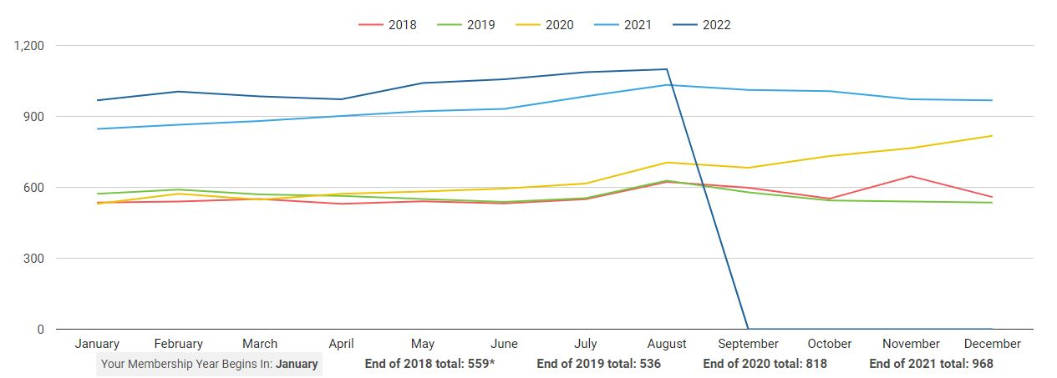
5- Year Membership Trend
*2022 Data represented to 8/31/2022
Overall consistent maintenance of membership numbers after largest gains in 2021
Largest represented groups are OT’s and Students

Slide 12
OT Membership 5-Year Trend
*2022 Data represented to 8/31/2022
Consistent overall trends
Largest gain between 2020 & 2021
Recent slight decline in the last few months

Slide 13
OTA Membership 5-Year Trend
*2022 Data represented to 8/31/2022
Consistent with OTR values there is stability in the overall trend
Largest gain between 2020 & 2021
Recent slight decline in the last few months

Slide 14
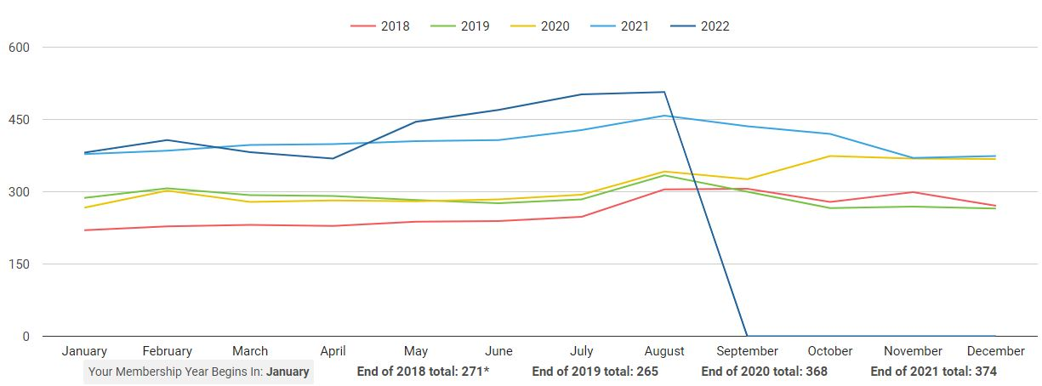
Student Membership 5-Year Trend
*2022 Data represented to 8/31/2022
Students remain the largest group of TNOTA members

Slide 15
Membership News
Removal of “Auto-renewal” and charging function based on member feedback
Collaboration between Social media & Membership to highlight member benefits
Marketing effort to educate members on the value of membership
Comparative analysis of the cost of membership and reduced/free service inclusions with membership
You reap the benefit of your membership with only the 2 required courses, even if you do not take advantage of every other benefit!
OT Membership $80/ OTA $60 | Savings
Conference Registration $400 $325 | $75
Required Ethics & Jurisprudence $40 Free | $40
Suicide Prevention $40 Free | $40
Ongoing Continuing Education opportunities $ 40 each | Endless value
Advocacy to protect our professional interests/ funding/ license | Priceless
New practitioner mentor | Priceless

Slide 16
Treasury Report
Kelsey Vaughn, OTD, OTR/L
 | YTD 2022 | YTD 2021 | Variance
Pinnacle Checking Account | $39, 903.72 | $39,818.55 | $85.17
Money Marketing Account | $113,915.52 | $72,631.51 | $41,284.01
Total Assets | $153,819.24 | $112,450.06 | $41,369.18

Slide 17
YTD Revenue
 | YTD 2022 | Budgeted | Variance
Conference | $11,965.00 | $19,000.00 | $7,035.00
Advertisements & Sponsorships | $260.00 | $1,000.00 | $740.00
Continuing Education | $23,468.61 | $27,340.00 | $3,871.39
Membership Dues | $28,930.00 | $41,540.00 | $12,610.00

Slide 19
YTD Expenses
 | YTD 2022 | Budgeted | Variance
Board Meetings | $209.76 | $200.00 | -$9.76
TNOTA Conference | $5,025.35 | $22,925.00 | $17,899.65
Continuing Education | $4,687.50 | $12,530.00 | $7,842.50
Misc (CC fees, Insurance) | $2,589.53 | $6,500.00 | $3,910.47
Legal and Professional | $12,650.80 | $17,200.00 | $4,549.20
Operating Expenses | $6,789.52 | $14,020.00 | $7,230.48
Travel | $796.41 | $850.00 | $53.59

Slide 22
TNOTA Conference Revenue
TNOTA Conference Revenue | YTD 2022
Exhibitor Fees | $1,600.00
Early Bird Full Day Registration | $2,500.00
Early Bird One Day Registration | $450.00
Member Full Conference Registration | $4,700.00
OT/OTA Member Full Day Registration | $4,775.00
OT/OTA Member One Day Registration | $350.00
OT/OTA Nonmember Full Day Registration | $775.00
OT/OTA Nonmember One Day Registration | $100.00
Student Registration | $60.00
Pre-Conference & Full Day Registration | $550.00
Pre-Conference Only Registration | $475.00
Selection Set – One Hour Event | $180.00
Selection Set – Two Hour Event | $150.00

Slide 24
TNOTA Conference Expenses
TNOTA Conference Expenses | YTD 2022
Audio/Visual | $244.98
Facility | $1,625.00
Food & Beverage | $100.00
Name Badges | $58.96
Programs/Printing | $1,132.03
Supplies | $16.27
Signage | $18.56
Conference Bags | $1,693.29
Mobile App | $108.16
Other (i.e., sales tax, service fees, etc.) | $28.10

Slide 26
Treasury Report
August
Income | $14,493.68
Expenses | $6,534.18
Highest Income | Member Dues
Highest Expense | Continuing Education Expenses
Net Income | $32,424.28

Slide 27
Year in Review 2021-2022
Strong leadership and member involvement
Membership growth
Legislative Successes
Telehealth reimbursement
OT licensure compact
Notes:
We’ll now move in to our year in review. TNOTA has seen quite a bit of growth and development this year. Between navigating the never-ending COVID situation, advocating for legislative changes, and launching new roles and committees within our association, TNOTA has seen some changes this year.

Slide 28
Year in Review 2021-2022 (continued)
Approved Provider Program
Notes:
Finally, over the past year the executive board has been working to refine TNOTA’s approved provider program. Per our state practice act, any CE course or provider approved by TNOTA is thereby approved for CE credit by our state licensure board. TNOTA has launched the Approved Provider Program in August 2021 and have received over 10 course submissions, including a rehab tech summit conference. We have also moved our process to be hosted entirely within the TNOTA website.
The TNOTA Approved Provider Program is TNOTA's mechanism for reviewing individual continuing education courses for approval with our association. This program assures that continuing education courses offered in partnership with TNOTA reflect the organization’s high standards for continuing education. Additionally, TNOTA reviews course content to ensure it is relevant to OT practitioners, draws on current evidence, and is offered by a presenter with sufficient background and expertise in the topic. Continuing education courses which meet criteria for approval and agree to adhere to the program guidelines will receive the designation of Approved Course by TNOTA. Approved Providers will be eligible to advertise their course through TNOTA’s media channels.
Please note, TNOTA approves courses on a case-by-case basis, and does not issue blanket approval for all of a provider's content.
This program supports and furthers our mission to provide support to our profession through continuing education and promotion of best practices in occupational therapy.

Slide 29
Year in Review 2021-2022 (continued)
Virtual Job Board
Notes:
TNOTA is proud to be able to offer courses necessary for licensure and certification in Tennessee, as well as other workshops covering special interest areas. We offer these courses in both online and in-person formats throughout the year.

Slide 30
Year in Review 2021-2022 (continued)
PAMs, QPR, E & J
Notes:
TNOTA is proud to be able to offer courses necessary for licensure and certification in Tennessee, as well as other workshops covering special interest areas. We offer these courses in both online and in-person formats throughout the year.

Slide 31
Year in Review 2021-2022 (continued)
Continued Aspire OT Partnership for hosting online CE courses
Notes:
Additionally, we are thrilled to continue partnering with Aspire OT to host our online continuing education content. We typically have several courses offered within a given month, and most courses are free for TNOTA members. We also have archives of past courses available on Aspire OT’s website for CE credit. Here are some of our course offerings from the past few months.

Slide 32
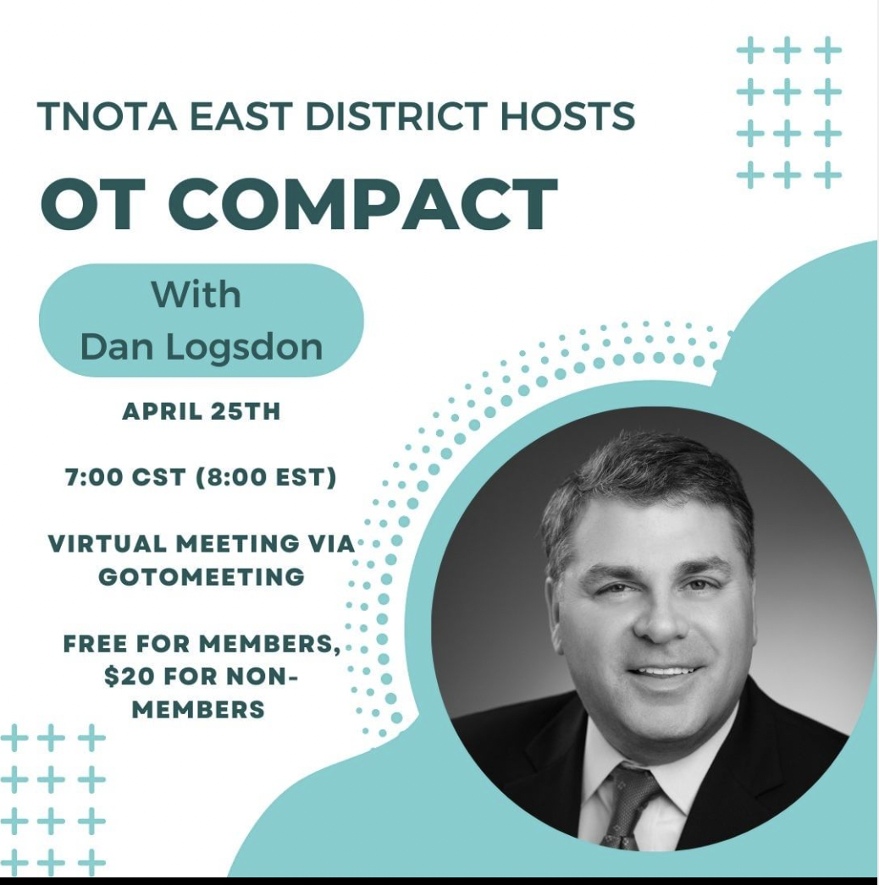
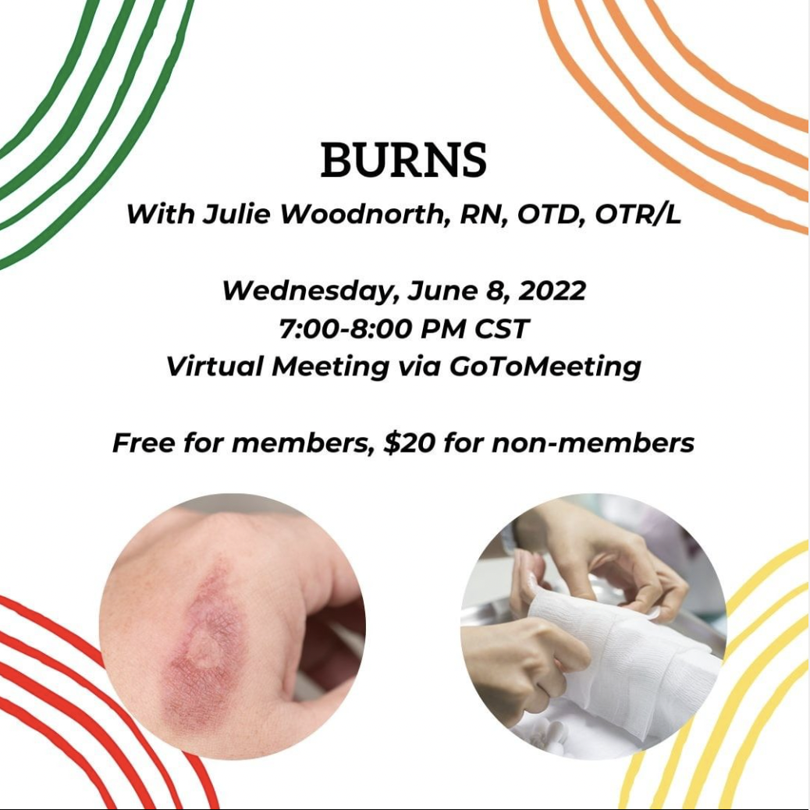
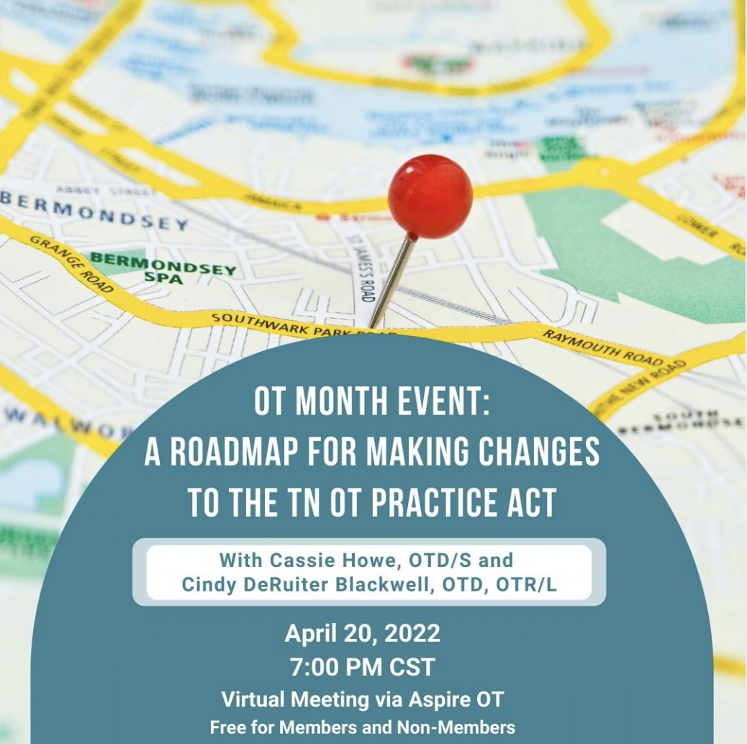
Notes:
Examples of some of our CE courses in 2022

Slide 33
Year in Review 2021-2022 (continued)
Communities of Practice
Peds
Mental health
Hand therapy

Slide 34
Year in Review 2021-2022 (continued)
Reciprocal Member Discounts with neighboring states

Slide 35
Looking ahead…
For the first time in recent memory, TNOTA will host a joint annual conference with the APTA-TN!
Save the date! October 14-15, 2023

Slide 36
Mental Health Committee
Mental Health Co-Chairs: Kaylin Flamm Lawrence, OTR/L and Megan Colletti OTR/L
Mental Community of Practice Lead: Katy Schmidt, OTD, OTR/L
Continues to provide QPR Suicide Prevention courses across the state for OT practitioners
Currently contacting states that have had successes in OT mental health legislative changes and reimbursement
Determined that QMHP status is not the most productive route for reimbursement for Mental Health OT in Tennessee
Mental Health Community of Practice is meeting quarterly with active discussions sharing resources and support
Next Meeting: November 1st at 7:00PM CST
Call for student volunteers for the Mental Health Committee
Focus on advocacy!

Slide 37
OTA Connect
OTA Connect was created in 2021 with the support and encouragement of TNOTA leadership to respond to the specific needs of occupational therapy assistants
Committee is comprised of practicing, licensed Certified Occupational Therapy Assistants.
We are working to promote this committee and plan on meeting quarterly to address the needs of OTAs within the profession.
OTA started last year and is still working on a full launch
If you are interested in promoting connection among OTAs, email OTAconnect@TNOTA.org

Slide 38
Communications & Marketing

Slide 39
Communication Team Members
Gwendolyn Foxx, MA, COTA/L (Chair)
Meagan Oslund, OTD, OTR/L
Morgan Webb, MOT, OTR/L
Bridget Joy, COTA/L
Richie Leger-Walker, MS, OTR/L

Slide 40
Communications Report
New TNOTA phone number – Google Voice
New Team Member: Richie Leger-Walker
Student opportunities to assist with communication team
Phone Calls are monitored daily
Emails are monitored daily with response within 24 hours or less
Volunteer Team

Slide 41
Communications: Marketing
Designing & managing social media posts
New marketing team member since October 2021: Morgan Webb
The TNOTA website logo has been updated.
The official TNOTA logos have been organized and the best images are utilized for marketing purposes.
The TNOTA website is updated regularly.
The TNOTA homepage has been updated to include largely graphics.
A monthly Newsletter continues to be emailed and now includes a new design template with the new TNOTA website logo.

Slide 42
Communications: Marketing
A “Membership Corner” has been added to the monthly email Newsletter to include the “Membership Benefit of the Month” and spotlighting of TNOTA members.
The TNOTA phone number has been updated on all email communications and the TNOTA website.
MemberClicks forms have been updated to streamline processes for our Executive Board Members.
The TNOTA Calendar has been updated to include a new "CEU Event” category.
Multiple companies/entities have advertised with TNOTA since September 2021.

Slide 43
TNOTA Diversity and Inclusion Committee
COTAD Chapters: advocated for TNOTA to pay 50% of initial fee, helped to establish 6 TN chapters thus far, 2 more in development
TWU, South College, TSU, LMU, Belmont, UTHSC
JSCC, ETSU in process
Our COTAD committee is still reaching out to COTA programs to discuss assisting them in getting Chapters started.
Committee has been using the slack communication platform to meet with current COTAD chapters to see how they are doing and keep constant communication with them.
TNOTA Diversity Webpage @ TNOTA.org

Slide 44
TNOTA Diversity and Inclusion Committee
Created social media posts/campaigns to promote diversity and inclusion within our field
In the coming weeks, Chair Stedmon Hopkins and other committee members will be going to one of our local high schools to discuss OT and answer questions the students may have
trying to encourage other chapters to do the same in their communities

Slide 45
TNOTA Diversity and Inclusion Committee
Committee is in the early stages of planning a clothes drives for high school students that may be in need.
identified a couple of schools here in Knoxville, may work with a Memphis program called Warming Hearts
plan on advertising for that and donations early to mid October.

Slide 46
TNOTA Diversity and Inclusion Committee
Launched original web series entitled “Anatomy of an Ally” in 2021, and Human Rights Series in 2022
Hosted JEDI-related CE courses

Slide 47
Student Involvement Committee
Rebecca Whittaker, OTD, OTR/L
Student Involvement Committee Chair

Slide 48
Student Involvement Committee
Mission: TNOTA’s student involvement committee is comprised of OT practitioners and OT/OTA students who work together to advocate for, support, and facilitate the success of students through a variety of initiatives, programs, and presentations designed specifically to assist in the growth of OT practitioners.
Student Sunday weekly posts
Student Social Media Takeovers
Student Quarterly Spotlight
Student Section on the TNOTA Website
Homepage, Student Forum, Quarterly Virtual Chats, Student Opportunities, Resources
Student Quarterly Virtual Chats
Oct. 4th: Entrepreneurship with Anna Anderson
Spring: Miles from OT exam prepper
NEW Student Leadership Meetings

Slide 49
“What is OT?” Student Video Contest
2022 Winner:
University of Tennessee Health Science Center

Slide 50
Mentorship Committee
Valery Hanks, OTR/L, CPAM, C/NDT
Mentorship Committee Co-Chair

Slide 51
Mentorship Committee
Co-chairs: Valery Hanks and Morgan Webb
7 committee members: 6 OTs and 1 OTA
Name changed from “Mentorship and Leadership Committee” to “Mentorship Committee” in July 2022
3rd Cycle of Mentorship Program: February 1-August 1, 2022, was smaller than previous cycles with 10 pairings
2nd cycle: 68 pairings
1st cycle: 34 pairings
Working with the Diversity of Inclusion Committee to share cycle demographics
The 4th Cycle will begin February 1, 2023 and run until September 30, 2023
Mentor applications will open November 1, 2022
Mentee applications will open December 1, 2022

Slide 52
Changes for the 4th Cycle
One cycle per year
Increasing time from 6 months to 8 months
Application component to be added regarding what mentorship pairs hope to gain from the program
Will be offering a CEU on Mentorship through Aspire OT in June 2023 for TNOTA members and non-members
Virtual check-ins/networking throughout the Cycle
Adding topics to the “List of Suggested Topics”
Adding question banks to some “List of Suggested Topics”
Project component will be added
Updated FAQs on the TNOTA website

Slide 53
4th Cycle Criteria
Must be current member of TNOTA
Have an active Tennessee OT or OTA license (practitioners)
Be enrolled in an OT or OTA program in Tennessee (students)
Students must be a 2nd year OT or OTA student by February 2023
By applying you agree to meet at least once a month

Slide 54
Tennessee Occupational Therapy Foundation (TNOTF)
The primary purpose of TNOTF is to partner with TNOTA to provide financial assistance, support, and encouragement to individuals and entities involved with the provision and receipt of occupational therapy services in Tennessee.
Check us out at www.tnotf.org

Slide 55
Tennessee Occupational Therapy Foundation (TNOTF)
TNOTF received its 501c3 nonprofit status in late 2020. As such, all donations made to the foundation are tax deductible. .
Fundraising efforts included the first annual 5K virtual “fund run” that generated over $500 for student scholarships.
Conference pins and totes are expected to raise $1,500 for scholarships.
The 2022 philanthropy organization is The Special Olympics. Formal events have been limited, but stayed tuned for ways to be involved!

Slide 56
Scholarship & Awards
This Photo by Unknown Author is licensed under CC BY-ND

Slide 57
Legislative Affairs Federal Report
Susan S. McDonald, Ed. D., OTR/L
TNOTA Legislative Chair

Slide 58
Occupational Therapy via Telehealth for Medicare Beneficiaries Support the Expanded Telehealth Access Act (H.R.2168/S.3193)
Support the Expanded Telehealth Access Act (H.R.2168/S.3193)
The Expanded Telehealth Access Act (H.R.2168/S.3193) was introduced by Reps. Mikie Sherrill (D-NJ) and David McKinley (R-WV) and Senators Steve Daines (R-MT) and Tina Smith (D-MN) to enable OT practitioners as well as PTs, SLPs, and audiologists to permanently provide services via telehealth under Section 1834(m) of the Social Security Act.
The bill is also endorsed by the American Physical Therapy Association (APTA), the American Speech-Language-Hearing Association (ASHA), the American Telemedicine Association (ATA), e-Health Initiative, the Personal Connected Health Alliance and the Alliance for Connected Care.

Slide 59
Support Medicare Beneficiaries’ Access to Therapy Services: Policy Recommendations To Mitigate the Impact of Pending 15% Medicare Cuts to Occupational Therapy Assistants and Physical Therapist Assistants
PROBLEM
Medicare beneficiaries soon will have less access to therapy services because of a new 15% payment cut for services provided by physical therapist assistants and occupational therapy assistants. We are particularly concerned that these changes will threaten access to care in rural and underserved areas, and result in unnecessary policy confusion and administrative burden.
SOLUTIONS
Congress should implement the following three policies to ensure that this 15% payment reduction is appropriate and without unintended negative consequences:
Provide an exemption to the 15% payment differential for rural areas.
Reduce the burdensome requirements for direct supervision of therapy assistants in
private practice settings.
Delay the payment differential to January 1, 2023, to give CMS more time to clarify how it
will be applied and to provide technical assistance to therapy providers.

Slide 60
Support Medicare Beneficiaries’ Access to Therapy Services: Policy Recommendations To Mitigate the Impact of Pending 15% Medicare Cuts to Occupational Therapy Assistants and Physical Therapist Assistants
Policy Recommendation
Provide an exemption to the therapy assistant payment differential in designated rural and medically underserved areas.
Policy Recommendation
Enact legislation that changes the Medicare supervision requirement of OTAs and PTAs in private practice to state that it cannot exceed requirements under State law.
Policy Recommendation
Delay implementation of the OTA and PTA payment differential to January 1, 2023.

Slide 61
Our Nation is Facing a Health Workforce Diversity Crisis
According to a study published in JAMA in March 2021, efforts are needed to increase the percentage of health care professionals from underrepresented populations.
“Federal policy must support efforts to support the creation of a health workforce more representative of the nation to increase access, service quality, and outcomes.”
Why the Allied Health Workforce Diversity Act?
The Allied Health Workforce Diversity (AHWD) Act would increase diversity among the professions of occupational therapy, physical therapy, respiratory therapy, speech-language pathology, and audiology by creating a grant program administered by the Health Resources & Services Administration (HRSA).

Slide 62
Increase Diversity in the Occupational Therapy Workforce Support the Allied Health Workforce Diversity Act: S.1679/H.R.3320
A more diverse health care workforce is important because:
Patients who receive care from members of their own racial and ethnic background tend to have better outcomes
Health professionals from underrepresented and minority backgrounds are more likely to practice in medically underserved areas
Minority groups disproportionately live in areas with provider shortages
A more diverse workforce and student population increases the sense of belonging and improves the quality of occupational therapy services to underserved populations

Slide 63
Increase Diversity in the Occupational Therapy Workforce Support the Allied Health Workforce Diversity Act: S.1679/H.R.3320
The bipartisan Allied Health Workforce Diversity Act (S.1679/ H.R.3320), introduced by Sens. Bob Casey (PA) and Lisa Murkowski (AK) in the Senate, and Reps. Bobby Rush (IL-01) and Markwayne Mullin (OK-02) in the House, will increase the number of individuals currently underrepresented in the professions of occupational therapy, physical therapy, respiratory therapy, speech-language pathology, and audiology.
This legislation creates a program administered by the Health Resources & Services Administration (HRSA) and funding to ensure the flexibility to adapt and change the groups that are underrepresented, in order to grow with a changing health care workforce.
This bipartisan legislation moves our nation closer to the goal of a health care workforce that mirrors society. It would provide HRSA with the tools and flexibility to reduce shortages, lower costs, and increase the quality of our nation’s health care workforce.

Slide 64
Increase Diversity in the Occupational Therapy Workforce Support the Allied Health Workforce Diversity Act: S.1679/H.R.3320
Write A Letter, Call or Tweet: Ask Congress to Support the Expanded Telehealth Access Act
Write A Letter, Call or Tweet: Ask Congress to Support the SMART Act and Three Policies That Will Protect OTAs
Write A Letter, Call or Tweet: Urge Congress to Support the Allied Health Workforce Diversity Act

Slide 65
Help Secure Medicare Coverage for Critical Wheelchair Technology
The Medicare program currently prohibits coverage for seat elevation and standing systems in power wheelchairs and views these systems as “not primarily medical in nature.” However, it can be difficult to navigate daily activities for those who use a wheelchair. The Centers for Medicare & Medicaid Services (CMS) is currently accepting public comments through Wednesday, September 14, about whether to cover power seat elevation systems for Medicare beneficiaries and will be considering additional comments about power standing systems at a later date. If you work with clients who use or would benefit from seat elevation, please consider submitting comments to CMS and let Medicare know how your patients and their caregivers can benefit from these technologies.
* AOTA Practice Pulse., August 30, 2022

Slide 66
The Basics of Bills
https://youtu.be/OgVKvqTItto
https://www.youtube.com/watch?v=OgVKvqTItto
School House Rock - I’m Just a Bill

Slide 67
AOTA Resources
https://cqrcengage.com/aota/Grassroots-Advocacy-Intensive

Slide 68
Legislative Update State Report
Prepared by:
Courtney Atnip, Founder
Capitol & 5th Public Strategies

Slide 69
Legislative Overview
The 112th Tennessee General Assembly adjourned Sine Die on April 28, 2022.
On behalf of TNOTA, Capitol & 5th tracked 40 bills.
For the 2022 legislative session, Capitol & 5th carried 2 bills on behalf of TNOTA, both of which passed and were enacted as Public Chapters.

Slide 70
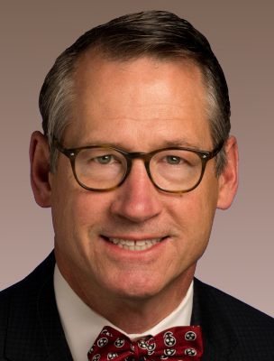
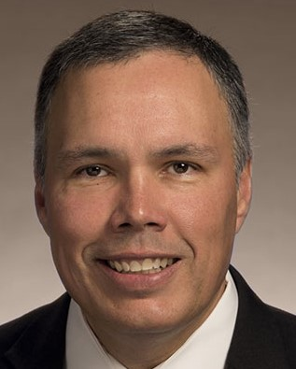
Occupational Therapy Licensure Compact
SB1848/HB2561, known as the “Occupational Therapy Licensure Compact”, amends TCA Title 4 and Title 63.
Enacted as Public Chapter 839 on April 19, 2022.
Facilitates interstate practice of occupational therapy for the purposes of improving public access to occupational therapy through mutual recognition of member state licenses. Also enacts the “Audiology and Speech-Language Pathology Interstate Compact" to facilitate interstate practice of audiology and speech-language pathology.
The compact is currently in the rule-making stage and will be in rule review in a few months.
Bill Sponsors:
Senator Bo Watson (left) Representative Bryan Terry (right)

Slide 71
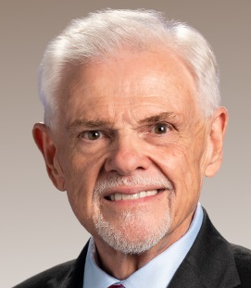
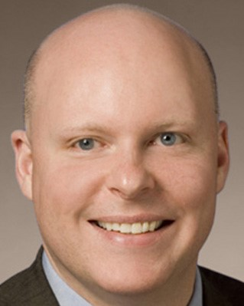
Telehealth Services Reimbursement Regulations
SB2453/HB2655, known as “Telehealth Services Reimbursement Regulations”, amends TCA Title 56 and § 63-1-155.
Enacted as Public Chapter 766 on April 1, 2022.
Extends the statutory provision regulating reimbursements for healthcare services provided during a telehealth encounter beyond April 1, 2022. Essentially, insurance companies are required to provide reimbursements indefinitely.
Bill Sponsors:
Senator Ken Yager (left) Representative David Hawk (right)

Slide 72
Legislation to Watch
TISA Bill
Governor Lee’s funding proposal for the state’s Basic Education Program (BEP) was a hot topic throughout the 2022 Legislative Session. The Tennessee Investment in Student Achievement (TISA) bill passed and was assigned Public Chapter 966 on May 2, 2022. It made several changes to the BEP formula.
The TISA bill will undergo a rule review some time in the coming months. This rule review will focus on funding requirements and may include changes that could impact school-based occupational therapists. We will keep you updated once we have more information regarding logistics of the rule review meeting.
Reimbursement issues within the Tenncare program are set to be discussed in a meeting between TNOTA and the Tenncare bureau in the coming months.

Slide 73
Member feedback and questions
What can TNOTA do to better serve its members?
What actions or deliverables would you like to see?
What questions do you have for TNOTA leadership?
president@tnota.org

Slide 74
Questions?

Slide 75
Adjournment of Annual Business Meeting

